Slide 1
GestaltMatcher facilitates rare disease matching using facial phenotype descriptors
Authors: Tzung-Chien Hsieh, Aviram Bar-Haim, Shahida Moosa, Nadja Ehmke, Karen W. Gripp, Jean Tori Pantel, Magdalena Danye, Martin Atta Mensah, Denise Horn, Stanislav Rosnev,Nicole Fleischer, Guilherme Bonini, Alexander Hustinx, Alexander Schmid, Alexej Knaus, Behnam Javanmardi, Hannah Klinkhammer, Hellen Lesmann, Sugirthan Sivalingam, Tom Kamphans, Wolfgang Meiswinkel, Frédéric Ebstein, Elke Krüger, Sébastien Küry, Stéphane Bézieau , Axel Schmidt, Sophia Peters, Hartmut Engels, Elisabeth Mangold, Martina Kreiß, Kirsten Cremer, Claudia Perne, Regina C. Betz , Tim Bender, Kathrin Grundmann-Hauser, Tobias B. Haack, Matias Wagner, Theresa Brunet, Heidi Beate Bentzen, Luisa Averdunk, Kimberly Christine Coetzer, Gholson J. Lyon, Malte Spielmann, Christian P. Schaaf, Stefan Mundlos, Markus M. Nöthen and Peter M. Krawitz

Slide 2
Genetic Diseases Affect Facial Phenotypes
Genetic disorders often affect how a person looks in a distinct way (known as a facial phenotype or a gestalt). This can help clinicians diagnose an individual.
More than 6.2% of the global population have some rare genetic disorder. Diagnosing these disorders can be difficult and time-consuming because of their rarity.
Highly recognizable gestalts can point doctors in the right direction, but only if they’re familiar with the gestalt in the first place.
Facial recognition systems can help identify disorders a clinician hasn’t seen.

Slide 3
DeepGestalt
A Clinical Face Phenotype Space (CFPS) is a collection of features extracted from images of patients with syndromes that come with gestalts for ML systems to train on.
Data is often taken from systems that take submissions about genetic variation too, such as ClinVar.
The state-of-the-art is DeepGestalt, which was trained on 20,000 patients and supports 300 syndromes. There are 3 major issues:
Most phenotypes have not been modeled due to insufficient data.
The offline, end-to-end training does not support easy addition of new syndromes.
Does not quantify similarities, which makes it difficult to identify new syndromes.

Slide 4
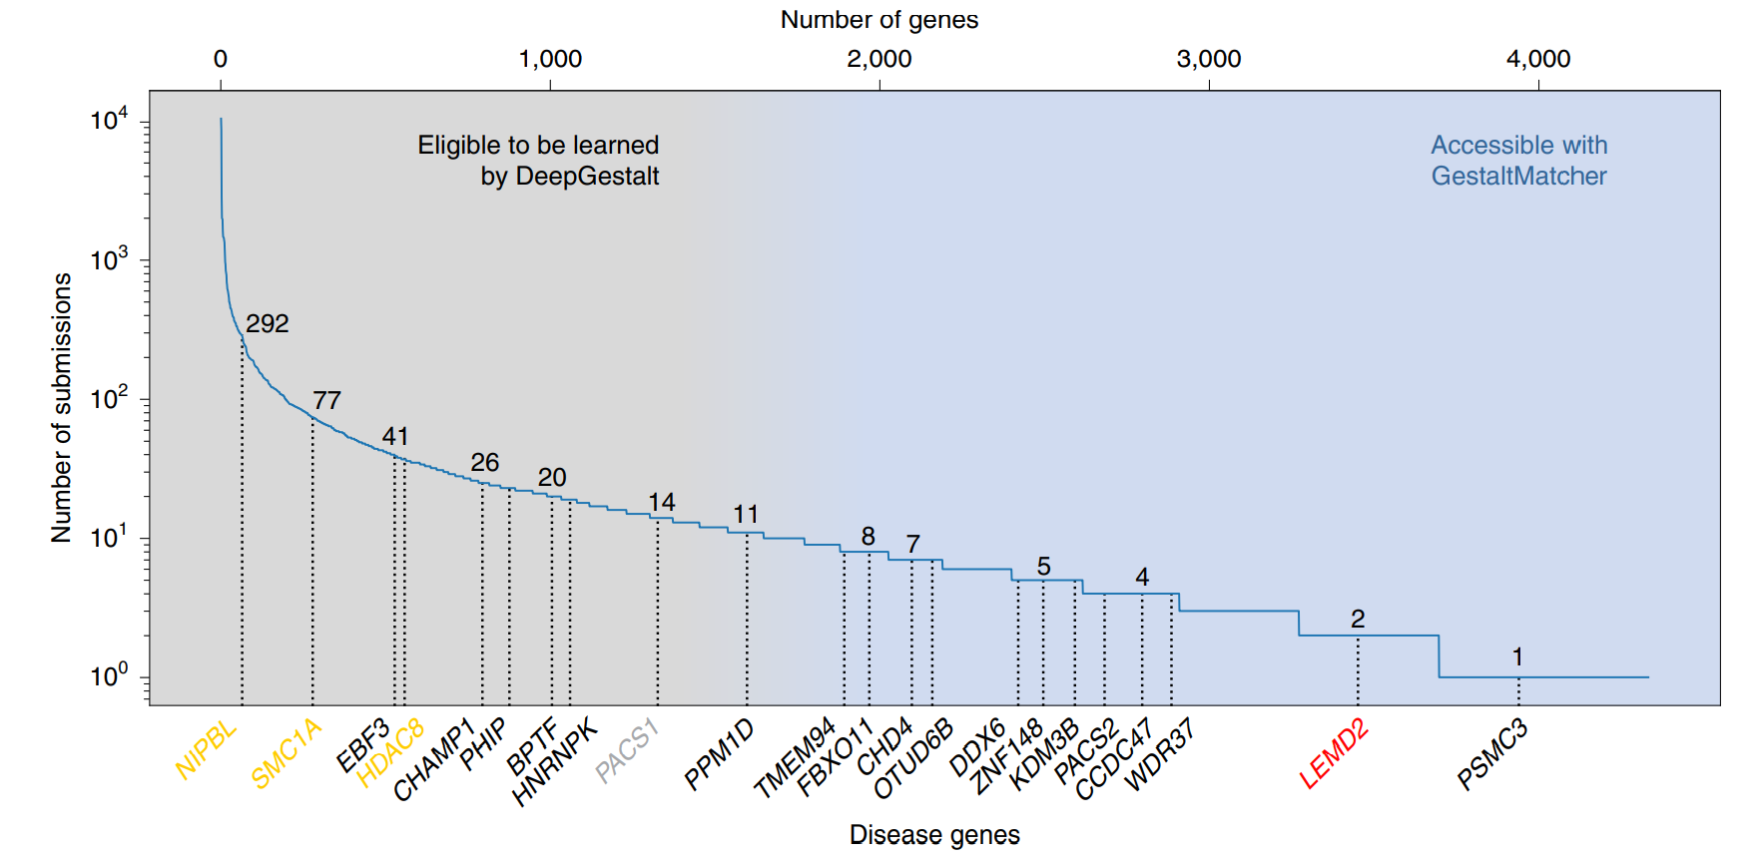
Syndrome Submission Frequency
Fig. 1 | Subsets of disorders supported by DeepGestalt and GestaltMatcher.

Slide 5
GestaltMatcher
Creates a CFPS by first generating image encodings known as facial phenotype descriptors (FPDs) for patients with know and unknown syndromes.
Clustering done on the resulting vectors can help identify similarities between cases. This can help in diagnosing disorders and discovering new disorders.
Has the advantage of supporting low-data and unseen syndromes.

Slide 6
Data
Process
Poor-quality images were removed
Divided into frequent (>=7) and rare (7>)
90/10 train-test
Cross-validation done with 90/10 split on rare set
CASIA-Webface used for “healthy” individuals training.
F2G is the main training dataset, GMDB was used to validate the results.
LMD was used to compare GestaltMatcher with DeepGestalt.
CASIA-WebFace
494,414 images of 10,575 individuals
F2G
Contains unpublished data
26,152 images from 17,560 individuals with 1,115 syndromes
139 frequent and 118 rare syndromes
GMDB
4,306 images of 3,693 individuals with 257 syndromes
299 frequent and 816 rare syndromes
London Medical Database (LMD)
323 images with 91 syndromes

Slide 7
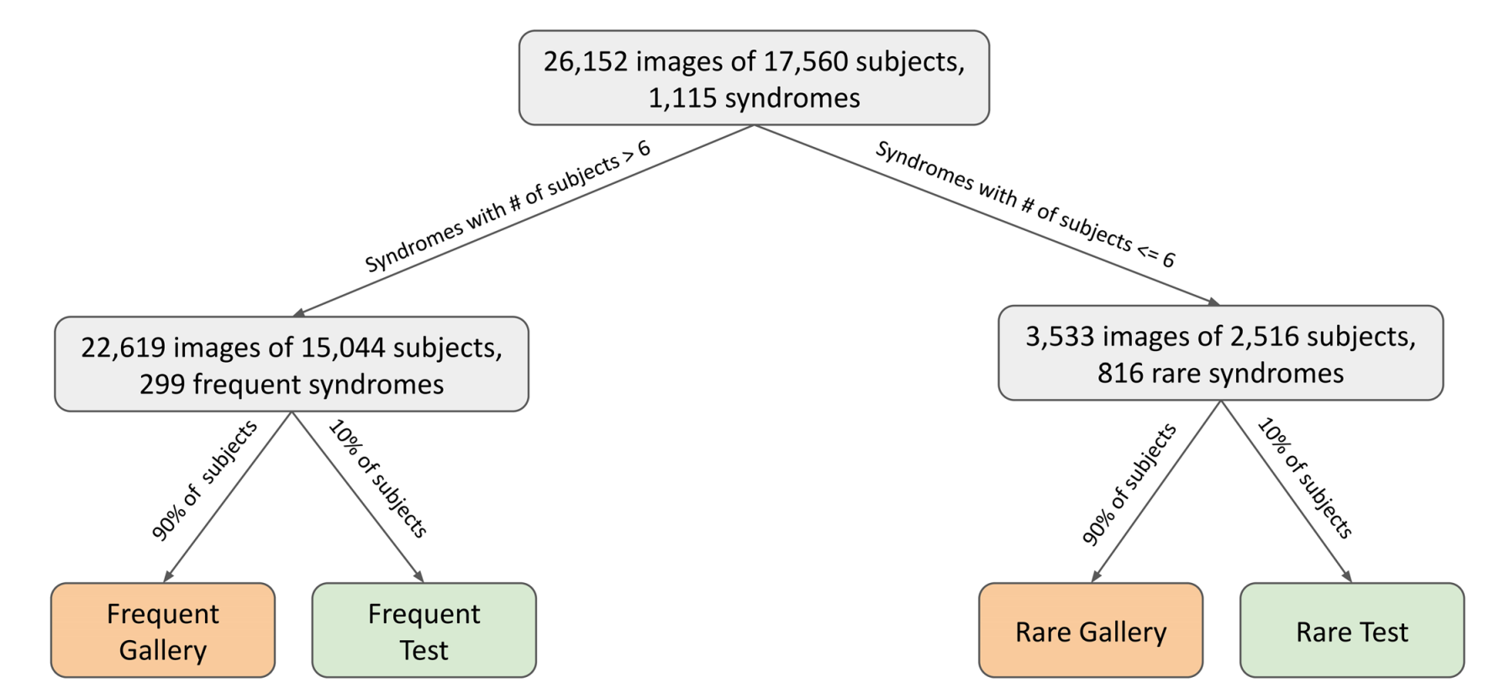
Data (Cont.)
Extended Data Fig. 7 | Overview of Face2Gene data categorization in GestaltMatcher.

Slide 8
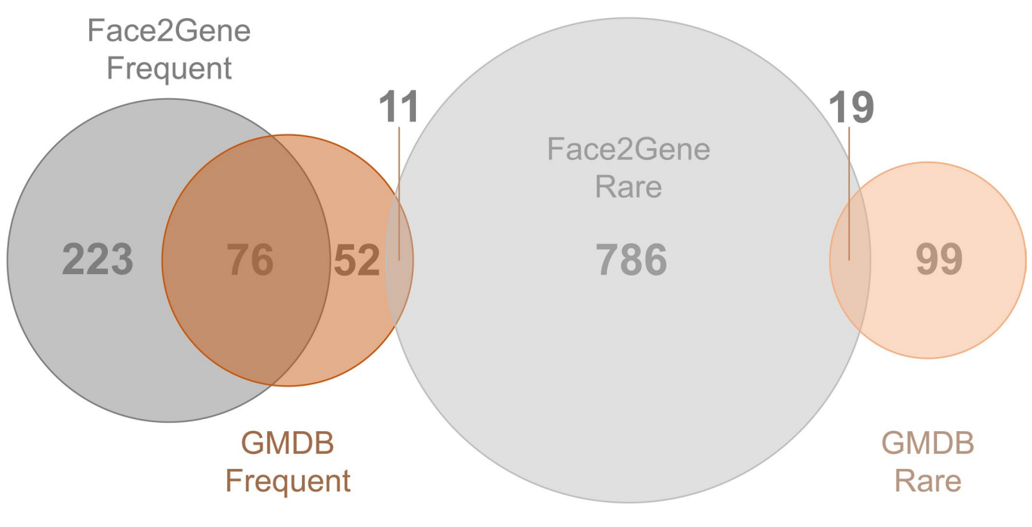
Data (Cont.)
Extended Data Fig. 8 | Venn diagram of numbers of syndromes in the Face2Gene and GMDB datasets.

Slide 9
Model
10 convolutional (conv) layers with batch normalization (BN) and ReLU activation to embed inputs. Max pooling applied after every conv-BN-ReLU to decrease spatial size and increase semantic representation.
Fully connected layer with 0.5 dropout follows.
Final layer is classification. This is removed during clustering and similarity tasks.
The fully connected layer is considered Facial Phenotype Descriptor (FPD), vector size 320.
First trained on CASIA-WebFace. Fine-tuned on either F2G or GMDB. Fine-tuning done with the rare set is done using 10-fold cross validation.

Slide 10
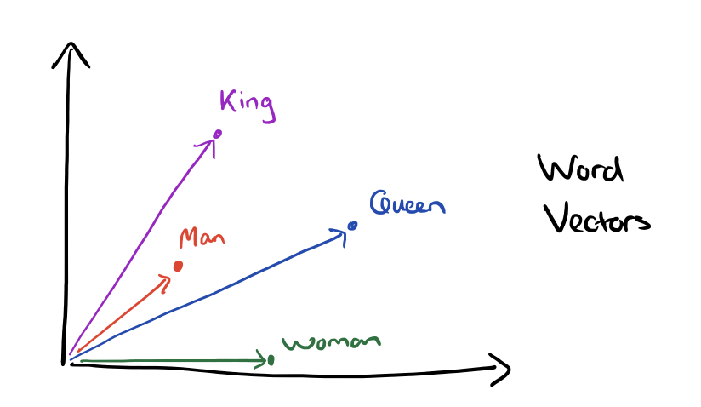
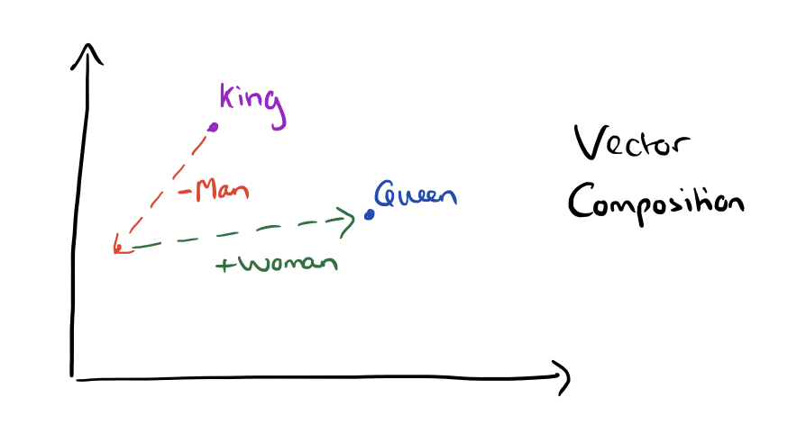
Encodings
An encoding is a vector of numbers representing an input. They can be manually created or generated by a ML model.
ML generated encodings have been known to contain information that allows numerical comparison and manipulation of data that wasn’t before.

Slide 11
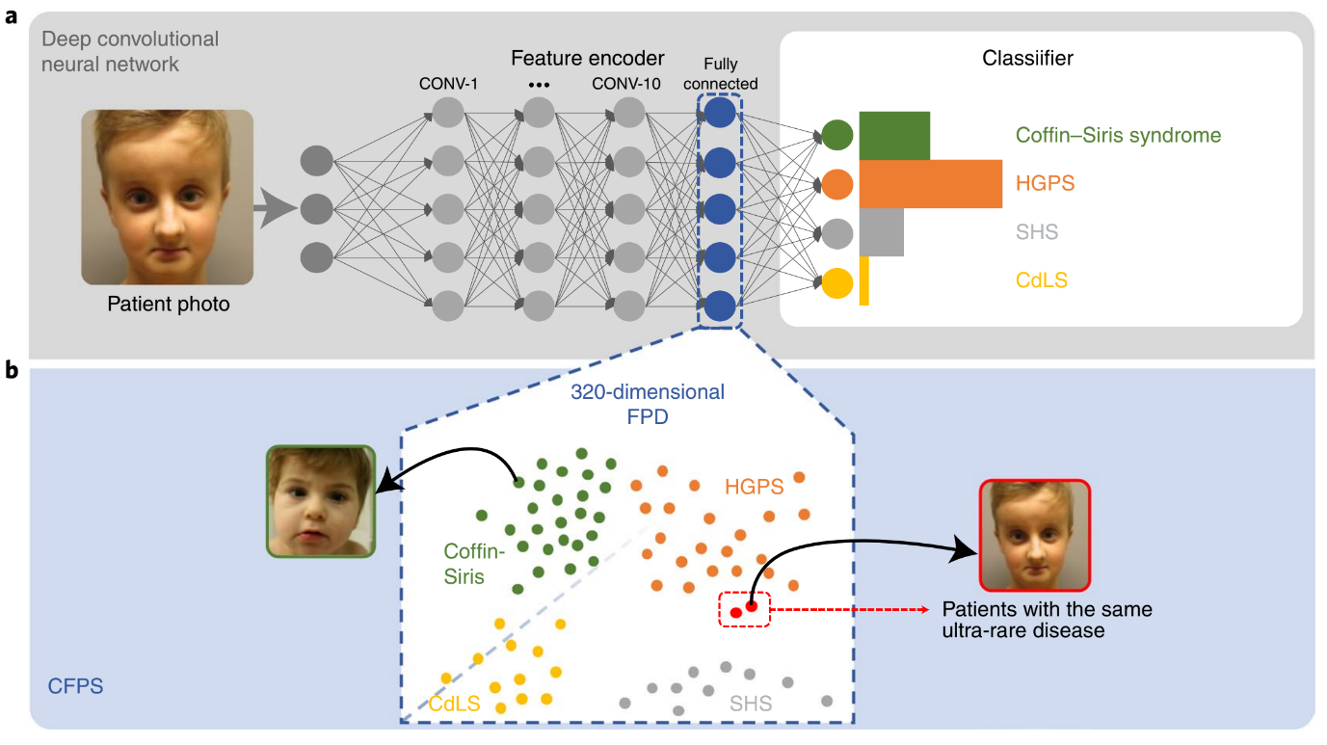
Model (Cont.)
Top: Architecture of the model, a DCNN.
Bottom: The clustered CFPS.
Fig. 2 | Concept of GestaltMatcher.

Slide 12
Results
To view importance of training specifically on syndromic images, the authors train Enc-Healthy on only CASIA-WebFace. Enc-F2G was trained on CASIA-WebFace then fine-tuned on the F2G dataset.
Top-k Accuracy: The percentage of test cases where the FPD was within the k closest diagnoses in the CFPS.

Slide 13
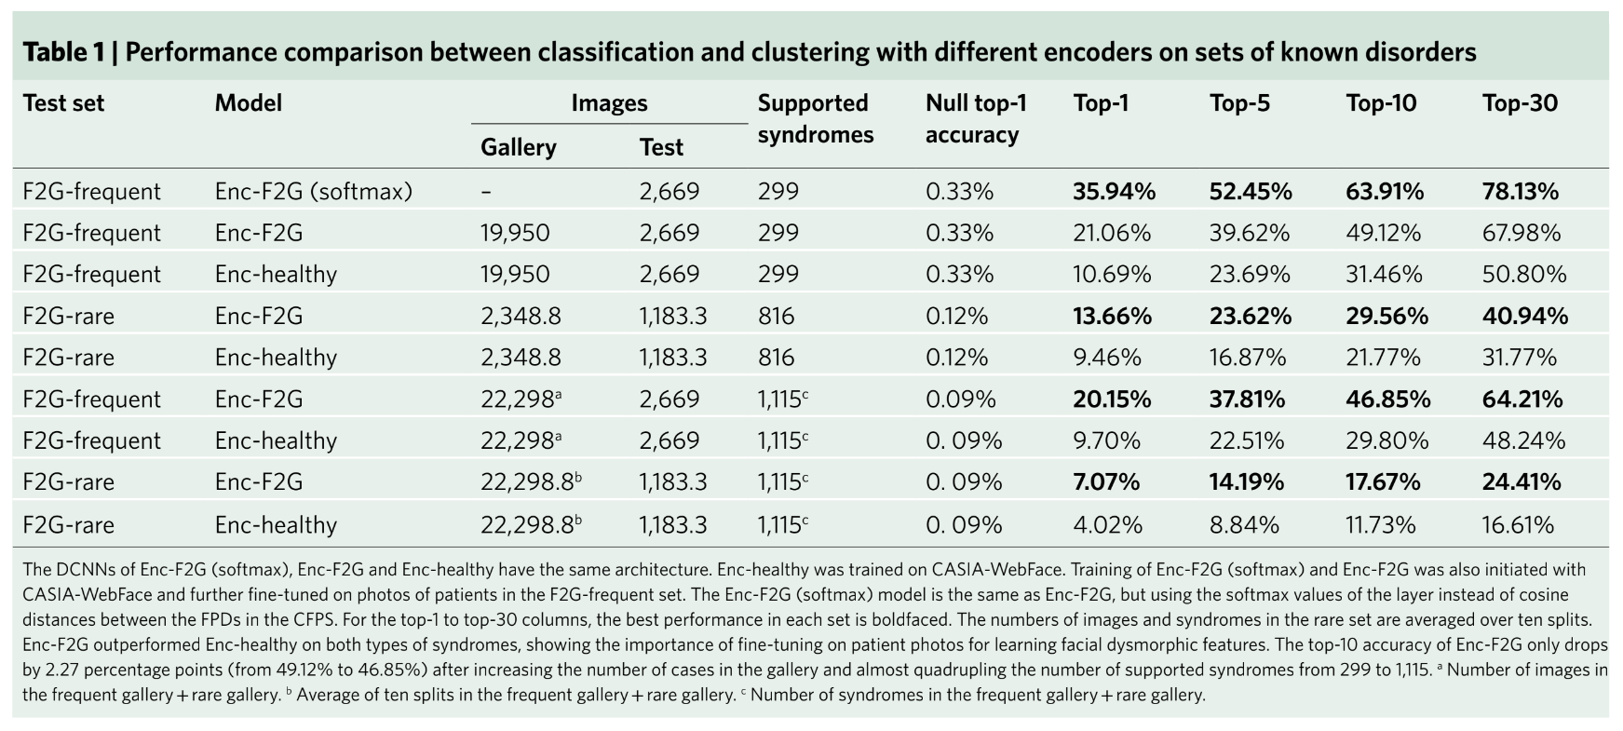
Results (Cont.)

Slide 14
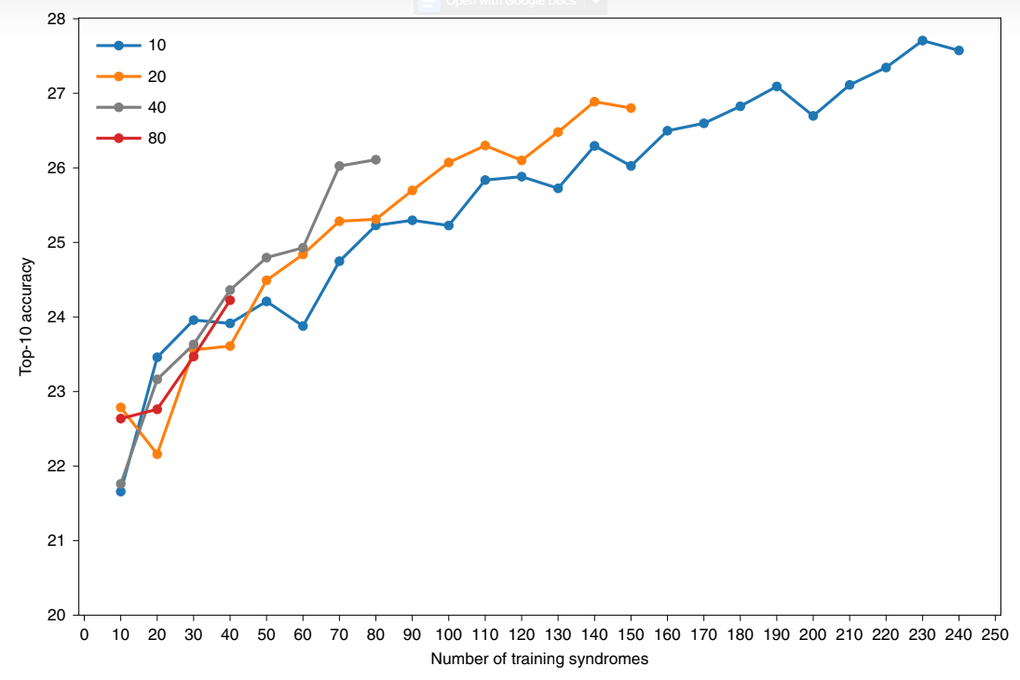
Results (Cont.)
Many of the rare syndromes have very few instances in the data and the gestalts are less distinct, which leads to class imbalance and could act as noise during training.
Each color is the number of subjects per syndrome.
Fig. 3 | Influence of the number of syndromes included in model training.

Slide 15
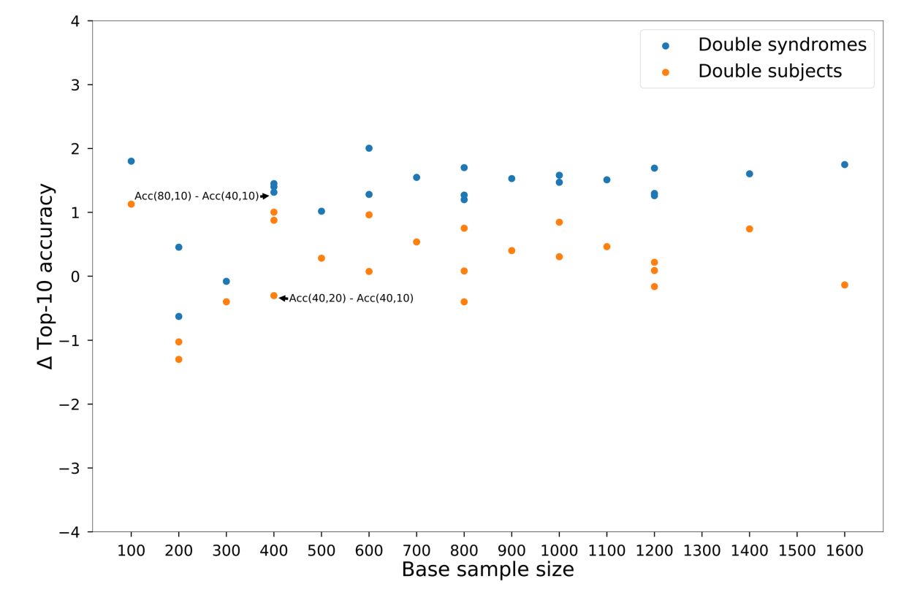
Results (Cont.)
ΔTop-10 Accuracy: Difference between the accuracy of the doubled syndromes or subjects and the base point.
Extended Data Fig. 1 | Performance improvement of double syndromes and double subjects when using different base sample sizes with Face2Gene models and the Face2Gene rare set.

Slide 16
Results (Cont.)
GestaltMatcher vs. DeepGestalt on Known Syndromes
When using frequent syndromes, GestaltMatcher reached 64.30% top-10 and 86.59% top-30 accuracy. DeepGestalt achieved 81.28% top-10 and 88.34% top-30 accuracy.
When using all syndromes (frequent + rare), GestlatMatcher’s top-10 and top-30 accuracies dropped by only 2.40 points and 5.17 points.

Slide 17
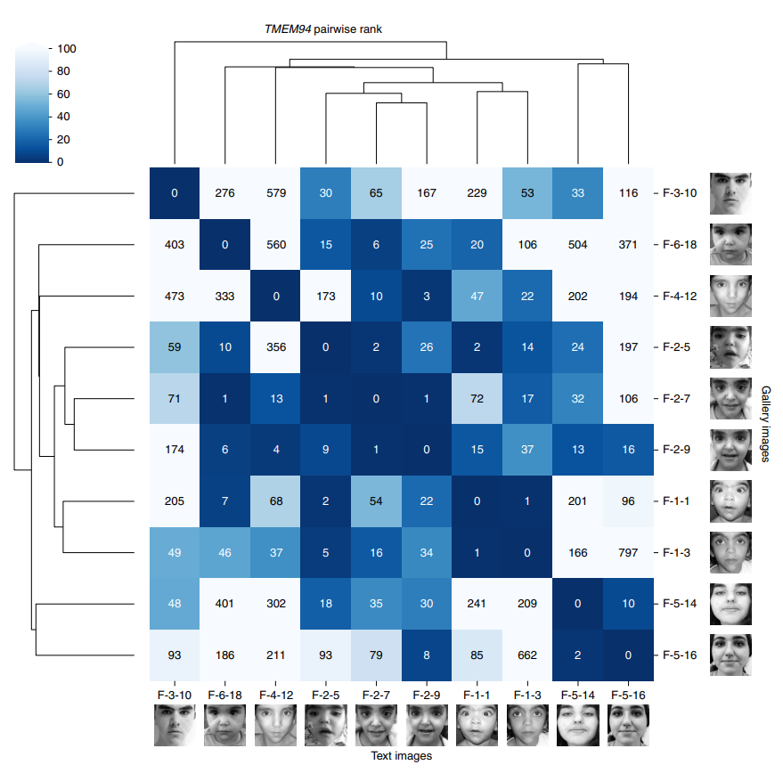
Results (Cont.)
Matching undiagnosed patients from unrelated families.
Here GestaltMatcher is meant to be a complement to GeneMatcher. Data was taken from GeneMatcher publications.
48 of 91 patients were matched, and 40 of 79 families were connected using top-10. Using only Enc-Healthy matched only 40 of 91 subjects and 34 of 79 families.
Fig. 4 | Pairwise ranks of individuals with mutations in TMEM94.

Slide 18
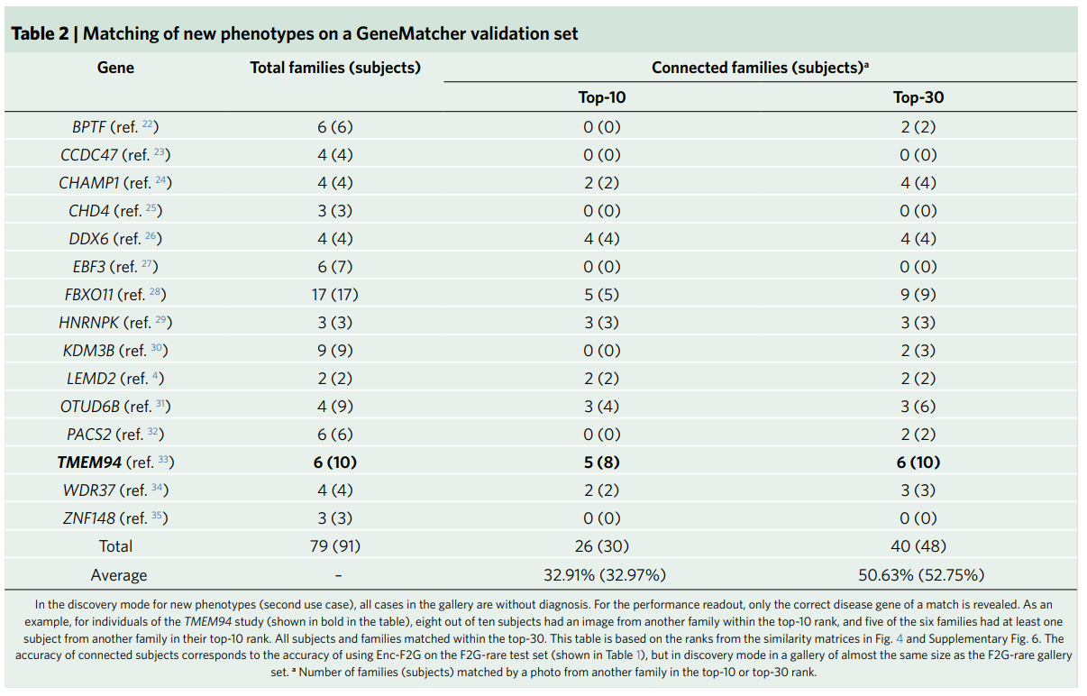
Results (Cont.)

Slide 19
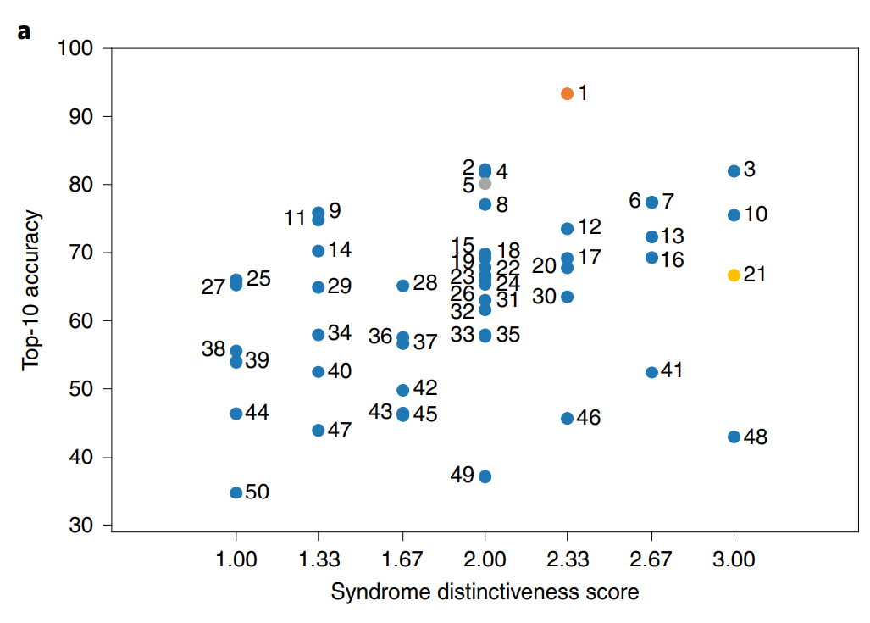
Results (Cont.)
GestaltMatcher and human experts agree on distinctness.
Three experts graded 299 syndromes from 1 to 3 for distinctness with 65.2% concordance.
50 syndromes for testing, 249 for training.
Average of human scores and top-10 accuracy were compared, Spearman’s rank correlation coefficient was 0.4 (P=0.004).
Syndromes with higher scores did better.
Fig. 5 | Correlation among syndrome prevalence, distinctiveness score and top-10 accuracy. a

Slide 20
Results (Cont.)
Characterization of phenotypes in the CFPS.
If a gene is identified as belonging to a new disease and the phenotypic similarities of the patients outweigh the differences, the phenotypes are grouped into a series by the Online Mendelian Inheritance in Man (OMIM).
Patients with a subtype of one of four large phenotypic series were sampled from the dataset and clustered using FPDs. The authors found high intersyndrome separability as well as considerable intrasyndrome substructure.

Slide 21
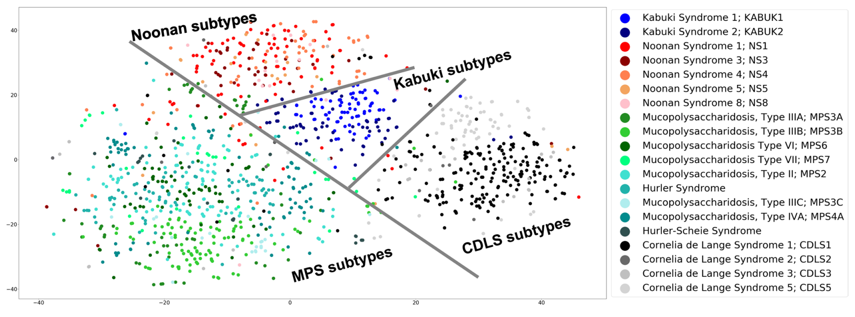
Results (Cont.)
Extended Data Fig. 4 | Hierarchical clustering of four phenotypic series using a t-SNE projection of the Facial Phenotype Descriptors.

Slide 22
Results (Cont.)
Demonstration of the separability of syndromes with facial dysmorphism.
The authors clustered 4,353 images of the ten most frequent syndromes as well as 872 images of ten syndromes without facial dysmorphism.
The Silhouette index of the frequent syndromes was 0.11, indicating some separability. The nondistinct syndromes had a -0.005 index, which indicates low to no separability.

Slide 23
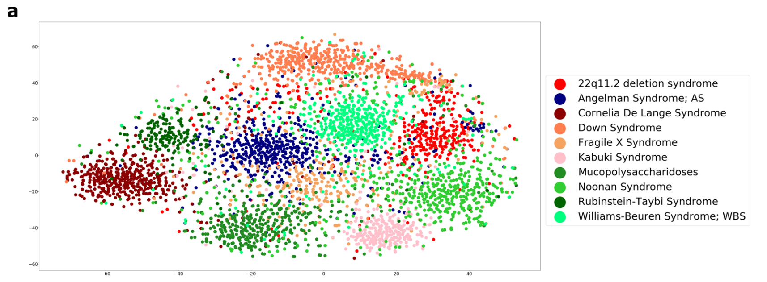
Results (Cont.)
Extended Data Fig. 5 | t-SNE visualization of Facial Phenotype Descriptors of syndromes with or without facial dysmorphism. a

Slide 24
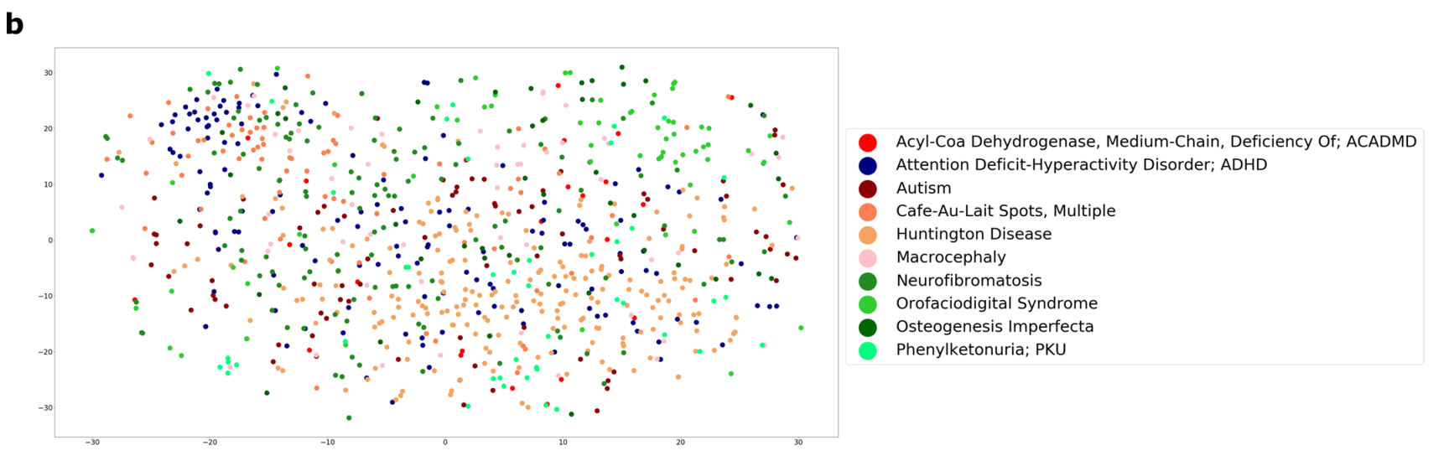
Results (Cont.)
Extended Data Fig. 5 | t-SNE visualization of Facial Phenotype Descriptors of syndromes with or without facial dysmorphism. b

Slide 25
Discussion
The ability to match previously unseen syndromes is an ability that is novel to GestaltMatcher. This will help clinicians with diagnosing extremely rare disorders as well as aid in discovering new syndromes.
GestaltMatcher is also extremely robust to scaling up the number of supported syndromes, even undiagnosed ones, which is unusual. This is supported by experiments showing that syndrome correlation is more important than syndrome prevalence.

Slide 26
References
Hsieh, T. C., Bar-Haim, A., Moosa, S., Ehmke, N., Gripp, K. W., Pantel, J. T., ... & Krawitz, P. M. (2022). GestaltMatcher facilitates rare disease matching using facial phenotype descriptors. Nature genetics, 54(3), 349-357.
https://blog.acolyer.org/2016/04/21/the-amazing-power-of-word-vectors/
https://www.geeksforgeeks.org/ml-label-encoding-of-datasets-in-python/
https://towardsdatascience.com/what-is-an-encoder-decoder-model-86b3d57c5e1a

Slide 27
Questions?

